Slide 1


Artificial Intelligence: mitigating bias
Understanding the Legislative & Regulatory Contexts

Slide 2
Overview
Accessibility
Limitations
Learning outcomes
Who we are
What we will cover
Lomas & Almeida 2021

Slide 3



Who we are
Dr Elizabeth Lomas
Associate Professor
Information Governance, UCL
e.lomas@ucl.ac.uk
Denise Almeida
Post Graduate
UCL
denise.almeida.18@ucl.ac.uk
Lomas & Almeida 2021

Slide 4
What we will cover
Part 1: Legislation and Regulatory Contexts
Part 2: Personal Data Concepts: the GDPR and AI
Part 3: GDPR in practice: RoPA
Part 4: Impact Assessments
Part 5 Case-Study: AI-driven Recruitment
Part 6: Future gazing: ePrivacy and AI regulation
Activities and Readings
Lomas & Almeida 2021
Notes:
Data is the new oil expresses its commoditization
Data as a resource for societal and individual good is perhaps better expressed as the concept of clean water
Key to driving AI
Location
Data bank/ lakes
Data gathering
Purpose
Proportionality
Explainability
Challenge

Slide 5

Readings and Activities Overview
Readings and activities have been provided for the respective parts of each learning unit.
These readings should form the point of departure for further reading.
Lomas & Almeida 2021

Slide 6
Part 1 Legislation and Regulatory Contexts
Lomas & Almeida 2021

Slide 7
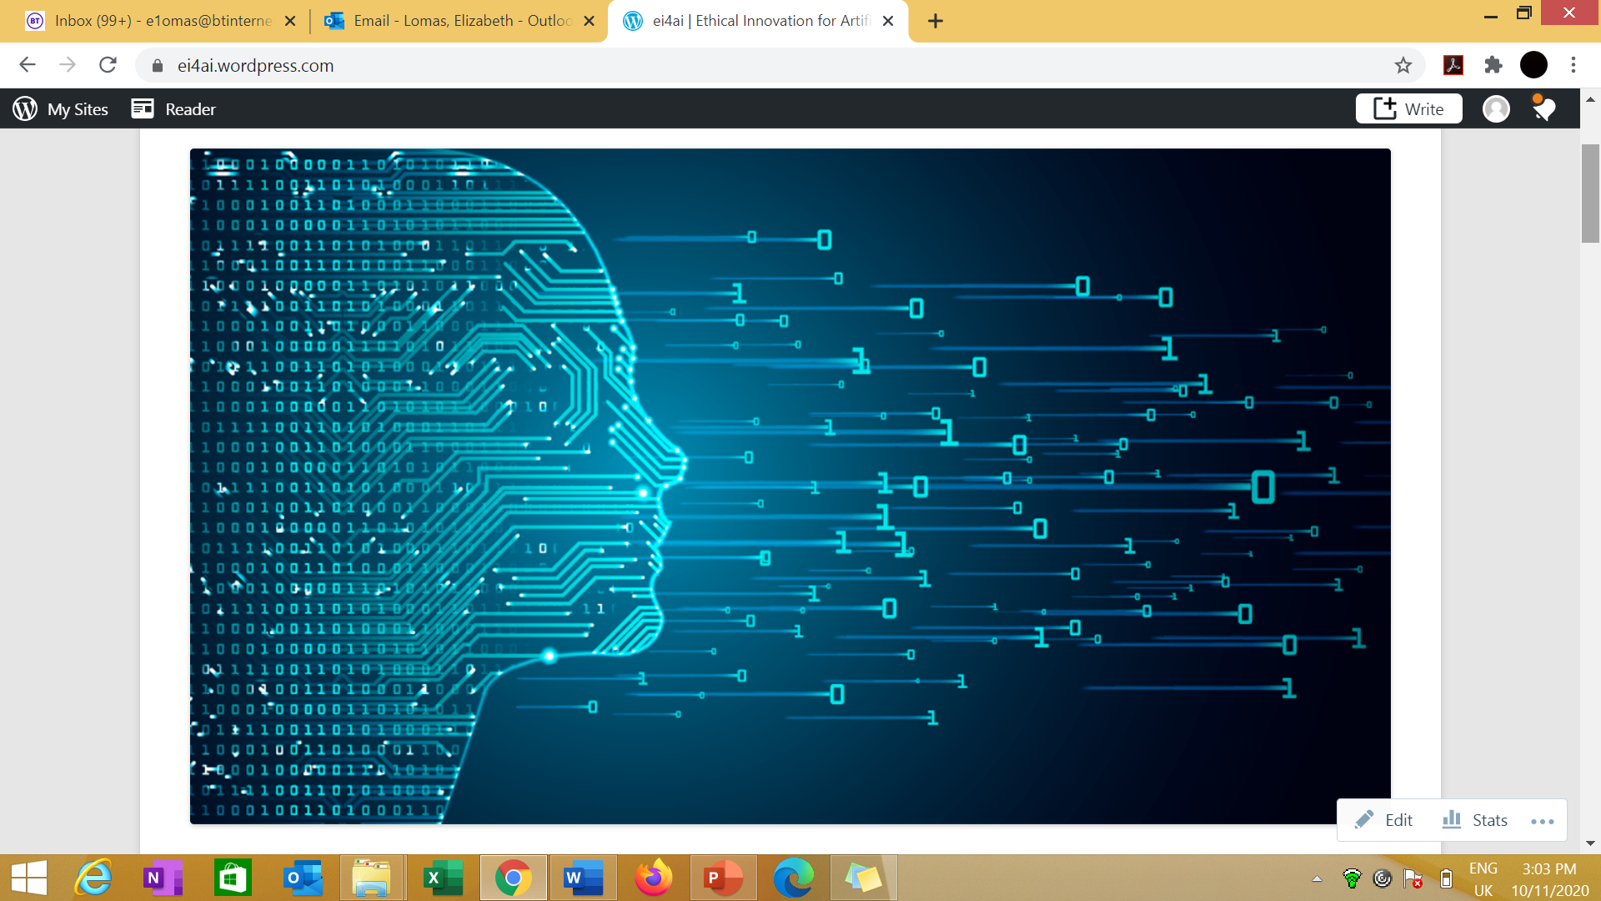
Ethical and Compliant AI Innovation
Developed
Deployed
User/end user
Location
Data/Data banks/lakes accrual
Purpose
Proportionality
Models
Accountability
Explainability
Challenge
Legal Responsibilities
Ethical Innovation for Artificial Intelligence
https://ei4ai.wordpress.com/
Lomas & Almeida 2021
Notes:
Data is the new oil!
OR
Good quality data, ethically and appropriately used is like the flow of water?

Slide 8

Global Legislative Contexts
Multiple jurisdictions and perspectives add to the complexity of compliance:
United Nations
European Union
UK
Canada
USA
China
India
Local/State
Lomas & Almeida 2021

Slide 9
Legislation and Societal Context
Society
Courts
Individual
Regulators
Intersection of:
Legislation
Case law
Regulators
Best practice
Public versus Private Law
Differing evidential standards
Warfare
Lomas & Almeida 2021

Slide 10

Risk Management
Legislation
Prescriptive- thou shalt
Balancing competing considerations
Avoiding negative impacts
Impact of Breaches
Financial
Harm
Damage
Providing for rights and freedoms
Lomas & Almeida 2021

Slide 11

Human Rights as a Foundation
Universal Declaration of
Human Rights - 1948
Article 7 – all equal before the law
Article 12 – right to privacy
Article 17 – right to property
Article 18 – right to freedom
of thought
Article 19 – right to freedom
of expression
Article 27 - right to the protection
of the moral and material interests
resulting from any scientific,
literary or artistic production
This Photo by Unknown Author is licensed under CC BY-NC-ND
Lomas & Almeida 2021

Slide 12
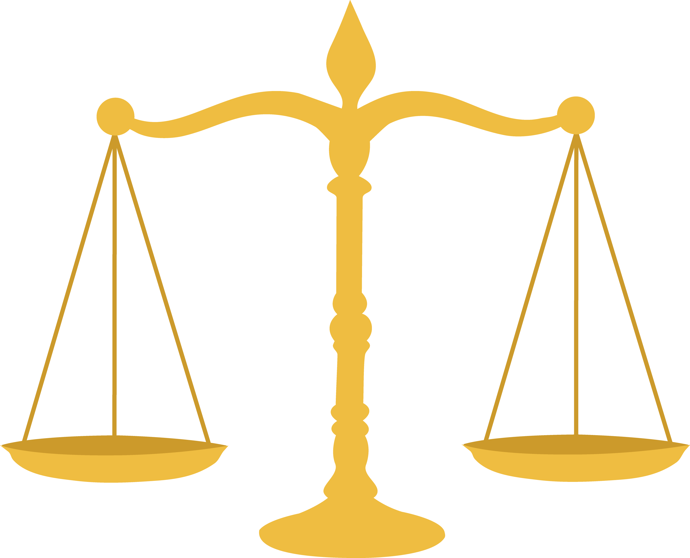
Equality, Diversity and Inclusion
EU Charter of Fundamental Rights (Article 21) UK Equality Act 2010 USA Civil Rights Act
Protected Characteristics
Age, Disability, Gender Reassignment, Marriage and Civil Partnership, Pregnancy and maternity, Race, Religion or Belief, Sex, Sexual orientation, Genetics, Language.
Direct, Indirect, Associative, Perceptive Discrimination
This Photo by Unknown Author is licensed under CC BY-NC
Lomas & Almeida 2021

Slide 13

Intellectual Property Rights
-Patents
-Industrial Design
-Trade secrets and ‘know how’
-Trade Marks
-Brand
-Copyright – needs human creator
-Digital Rights Management
-Software, Database Rights etcs
Legislated for in different ways
Last for different times
Differ internationally
Lomas & Almeida 2021
Notes:
Patents 20 years Trade marks renew every 10 years.
Industrial Design – registered design
Presenting your work at trade shows/conferences/exhibitions could be a disclosure.
•Leaving your work unattended or on white boards.
•Discussing sensitive information in public areas.
•Store your confidential information securely.
•Ensure those who you do disclose to agree to and understand your confidentiality.
•If you do need to talk to 3rd parties about your work – WHAT do you actually need to tell them? (can you get the message across without disclosing the confidential information?).
https://www.open.edu/openlearn/ocw/pluginfile.php/801396/mod_resource/content/3/Session%206%20WIPO%20What%20is%20intellectual%20property%20booklet.pdf#:~:text=An%20industrial%20design%20refers%20to,as%20patterns%2C%20lines%20or%20color.

Slide 14
Intellectual Property Rights
Provides for:
- Control
- Collaboration Frameworks
- Commoditization
- Monopolies
- Protection
Software is protected by copyright law – provides paternity and moral rights
Fair Dealing vs Fair Use
Inventions related to software are protected by patents
Trade secrets – contracts/NDAs
Lomas & Almeida 2021
Notes:
Patents 20 years Trade marks renew every 10 years.
Industrial Design – registered design
Presenting your work at trade shows/conferences/exhibitions could be a disclosure.
•Leaving your work unattended or on white boards.
•Discussing sensitive information in public areas.
•Store your confidential information securely.
•Ensure those who you do disclose to agree to and understand your confidentiality.
•If you do need to talk to 3rd parties about your work – WHAT do you actually need to tell them? (can you get the message across without disclosing the confidential information?).
https://www.open.edu/openlearn/ocw/pluginfile.php/801396/mod_resource/content/3/Session%206%20WIPO%20What%20is%20intellectual%20property%20booklet.pdf#:~:text=An%20industrial%20design%20refers%20to,as%20patterns%2C%20lines%20or%20color.

Slide 15

World Intellectual Property Organisation
“Our mission is to lead the development of a balanced and effective international IP system that enables innovation and creativity for the benefit of all. Our mandate, governing bodies and procedures are set out in the WIPO Convention, which established WIPO in 1967.”
https://www.wipo.int/about-wipo/en/
This Photo by Unknown Author is licensed under CC BY-SA
Lomas & Almeida 2021

Slide 16
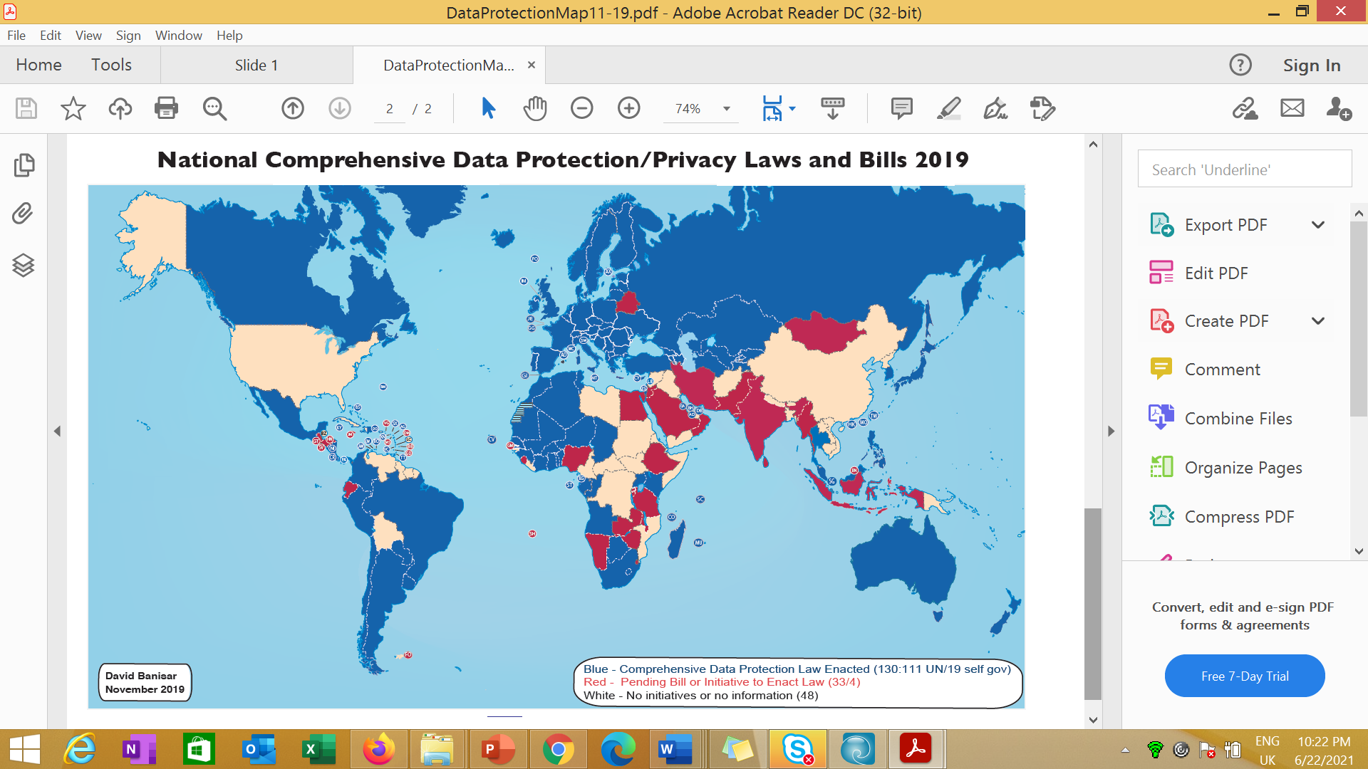
Privacy and Personal Data: Mapping of information privacy regimes
This image is produced with permission of David Banisar. See https://www.researchgate.net/publication/337060085_National_Comprehensive_Data_ProtectionPrivacy_Laws_and_Bills_-_November_2019
Lomas & Almeida 2021

Slide 17
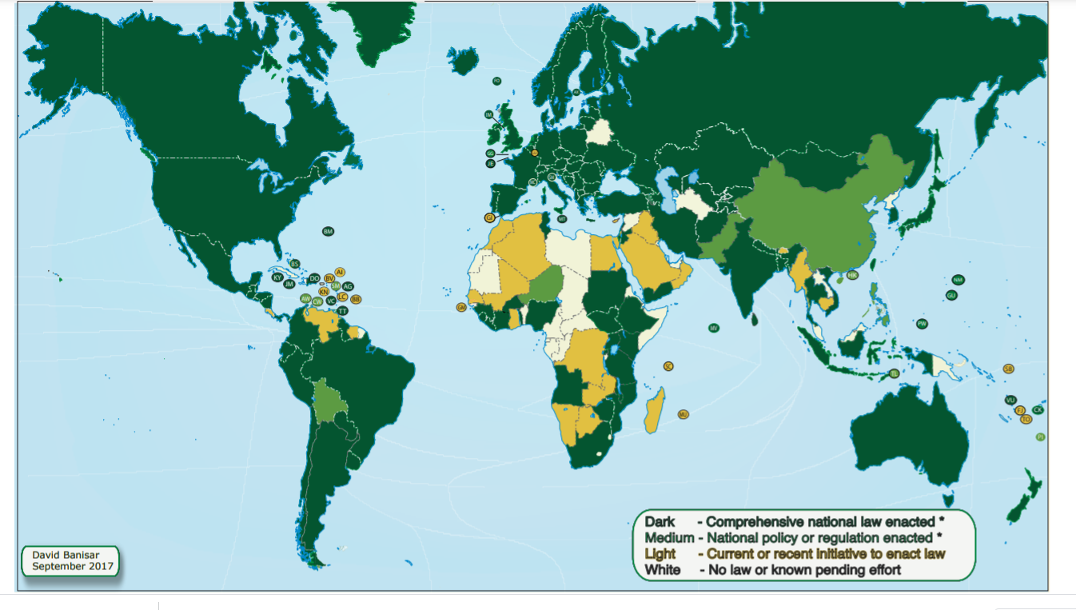
Mapping of information access regimes
This image is produced with permission of David Banisar. See https://www.researchgate.net/publication/256010224_National_Right_to_Information_Laws_Regulations_and_Initiatives_2017_Map
Lomas & Almeida 2021

Slide 18

Activity: Mapping out the legislative and regulatory landscape
To map out the legislative context either for your organization or an organization you are familiar with. Consider:
What is the broad legislative context?
Who are the regulators?
How/where/why might AI be developed/deployed?
Who are the stakeholders?
What could be the benefits of AI in this context?
What might be the risks taking into account any issues around potential harm or damage or rights infringements?
Lomas & Almeida 2021

Slide 19
Part 1 - Readings
Read Chapter 3 on ‘Who bears responsibility for the threats, risks, harms and wrongs posed by advanced digital technologies?’, in Yeung, K. ed. (2019) Responsibility and AI: a study of the implications of advanced digital technologies (including AI systems) for the concept of responsibility within a human rights framework. Strasbourg: Council of Europe. Available at: https://rm.coe.int/responsability-and-ai-en/168097d9c5 (Accessed 1 July 2021)
Lomas & Almeida 2021

Slide 20
Part 2 Personal Data Concepts: The GDPR and AI
Notes:
Part 1: Legislation and Regulatory Contexts
Part 2: Intellectual Property Rights
Part 3: Personal Data Concepts: the GDPR and AI
Part 4: GDPR in practice: RoPA
Part 5: GDPR in practice: Impact Assessments
Part 6 Case-Study: AI-driven Recruitment
Part 7: Future gazing: ePrivacy and AI regulation
Activities and Readings

Slide 21
GDPR Principles
Accountability
Processed lawfully, fairly and in a transparent manner
("lawfulness, fairness and transparency”)
Collected for specified, explicit and legitimate purposes
(“purpose limitation”)
Adequate, relevant and limited to what is necessary
(“data minimisation”)
Demonstrate compliance
Accurate and, where necessary, kept up to date
(“accuracy”)
Kept in a form which identifies individuals for no longer than necessary (“storage limitation”)
Processed in a manner that ensures appropriate security
(“integrity and confidentiality”)
Transparency
Lomas & Almeida 2021

Slide 22

General Data Protection Regulation: special category data
racial or ethnic origin;
political opinions;
religious or philosophical beliefs;
trade union membership;
data concerning health or sex life and sexual orientation;
genetic data and biometric data when processed to uniquely identify a person
Lomas & Almeida 2021

Slide 23
Processing
All processing needs a legal basis
processing personal data...
processing special category data...
Consent
Legitimate interests
Explicit consent
Legal claims or courts
Vital interests
Performance of a contract
Vital interests
Preventative or occupational medicine
Compliance with a legal obligation
Employment law obligation
Made public by data subject
Public interest
Archiving, research, statistics
Substantial public interest
Lomas & Almeida 2021

Slide 24

GDPR: children
UK children under the age of 13 can never, themselves, give consent to the processing of their personal data in relation to online services.
For UK children between the ages of 13 and 15 (inclusive), the general rule is that if an organisation seeks consent to process their personal data, then parental consent must be obtained, unless the relevant individual Member State legislates to reduce the age threshold – although the threshold can never drop below 13 years of age.
Children aged 16 or older may give consent for the processing of their personal data themselves.
Lomas & Almeida 2021

Slide 25

GDPR responsibilities
Data Controller(s) –
Data sharing agreement
Data Processor -
Data processing agreement
Human intervention and decision making
Lomas & Almeida 2021

Slide 26
General Data Protection Regulation: getting it wrong
Regulatory powers
ICO Fines
up to 20 Million Euro
(or 4% Turnover)
up to 10 Million Euro (or 2% Turnover)
Public reprimands and warnings
Getting the principles wrong
Not reporting breaches to the ICO
Order into compliance
Order to rectify, restrict or erase
Infringing the rights of an individual
No privacy by design
Order to temporarily stop processing
Order a stop to international data sharing
Sharing personal data overseas without safeguards
No records of processing
Lomas & Almeida 2021

Slide 27

General Data Protection Regulation: Privacy by Design
Privacy by Design systems to minimize DP risks, such as data minimisation, anonymisation, pseudonymisation
DP documentation of processes – Records of Processing
Data Protection Impact Assessments
Algorithmic Impact Assessments
Privacy Notices
Lomas & Almeida 2021

Slide 28

General Data Protection Regulation: Privacy by Design
Data Protection Impact Assessments (Article 35)
Human Intervention and Automated Decision Making
(Article 13, 15, 22)
Algorithmic Impact Assessments
See Article 29 Working Party/European Data Protection Board Guidelines
Lomas & Almeida 2021
Notes:
For example, in the algorithmic governance context, a data subject has a right to contest an individual algorithmic decision (Article 22), to receive notice of solely automated decision-making (ADM) (Article 13), and to request access to ‘meaningful information about the logic involved’ (Article 15). Should this fail to invoke any of these rights, however, the GDPR still puts in place significant obligations on data controllers using ADM, whether that decision-making involves a human or not.⁶ The GDPR requires an array of systemic accountability tools, including third-party auditing, the appointment of DPOs (Article 37), and DPIAs (Article 35). These obligations arise from the text of the law, in accompanying Recitals, and in the Guidelines on Automated Individual Decision-making and Profiling (‘Guidelines on ADM’) released in October 2017 and revised in February 2018 by the Article 29 Working Party (now the EDPB).⁷

Slide 29

Wider Context
Automated Decision Systems Accountability Act – California
Fair Credit Reporting Act – Federal Law
Lomas & Almeida 2021
Notes:
California. Enacts the Automated Decision Systems Accountability Act and states the intent of the Legislature that state agencies use an acquisition method that minimizes the risk of adverse and discriminatory impacts resulting from the design and application of automated decision systems.
The Fair Credit Reporting Act (FCRA) is a federal law that regulates credit reporting agencies and compels them to insure the information they gather and distribute is a fair and accurate summary of a consumer's credit history. ... The law is intended to protect consumers from misinformation being used against them.

Slide 30
Part 2 – Readings
Read the ICO’s 2020 discussions on addressing risks of bias and discrimination in AI design which are at https://ico.org.uk/for-organisations/guide-to-data-protection/key-data-protection-themes/guidance-on-ai-and-data-protection/what-do-we-need-to-do-to-ensure-lawfulness-fairness-and-transparency-in-ai-systems/#howshouldweaddress . These sections are within its Guidance on Data Protection and AI. The full publication is available at: https://ico.org.uk/for-organisations/guide-to-data-protection/key-data-protection-themes/guidance-on-ai-and-data-protection/ (Accessed 1 July 2021). Whilst this is a guide from the UK's Information Commissioner, it provides considerations of how to build an AI framework which is compatible with data protection legislation and as a whole will provide you with many critical points for developing and deploying an AI system.
Lomas & Almeida 2021

Slide 31
Part 2 – Activities
In addition, building on your Part 1 mapping of the regulatory and legislative landscape, you may wish to look at one of the following links, considering global differences and synergies in data protection law. The DLA Piper link provides an easy tool for comparisons.
Data Protection and Privacy Legislation Worldwide
https://unctad.org/page/data-protection-and-privacy-legislation-worldwide
DLA Piper’s Data Protection Laws of the World
https://www.dlapiperdataprotection.com/
EU GDPR Law Comparison
https://www.activemind.legal/law/
Lomas & Almeida 2021

Slide 32
Part 3 GDPR in Practice: Records of Processing Activities (ROPA)
Notes:
Part 1: Legislation and Regulatory Contexts
Part 2: Intellectual Property Rights
Part 3: Personal Data Concepts: the GDPR and AI
Part 4: GDPR in practice: RoPA
Part 5: GDPR in practice: Impact Assessments
Part 6 Case-Study: AI-driven Recruitment
Part 7: Future gazing: ePrivacy and AI regulation
Activities and Readings

Slide 33

Records of Processing Activity (ROPA)
Defined in art. 30 of the GDPR,
Records detailing all of the processing activities of controllers or processors:
Details of controller and/or processor
Purpose of the processing
Description of the categories of data subjects and data recipients
Details on transfers to third-countries or international organisations
Description of technical and organisational security measures
Lomas & Almeida 2021

Slide 34

What can the records be used for?
Provide evidence of accountability;
Assist in breach investigations and/or responding to individual rights requests;
Highlighting areas of risk which require Data Protection Impact Assessments;
Inform policy and procedure development;
Facilitate the maintenance of retention schedules.
"Europe GDPR PD" by Harakir is marked with CC0 1.0
Lomas & Almeida 2021

Slide 35
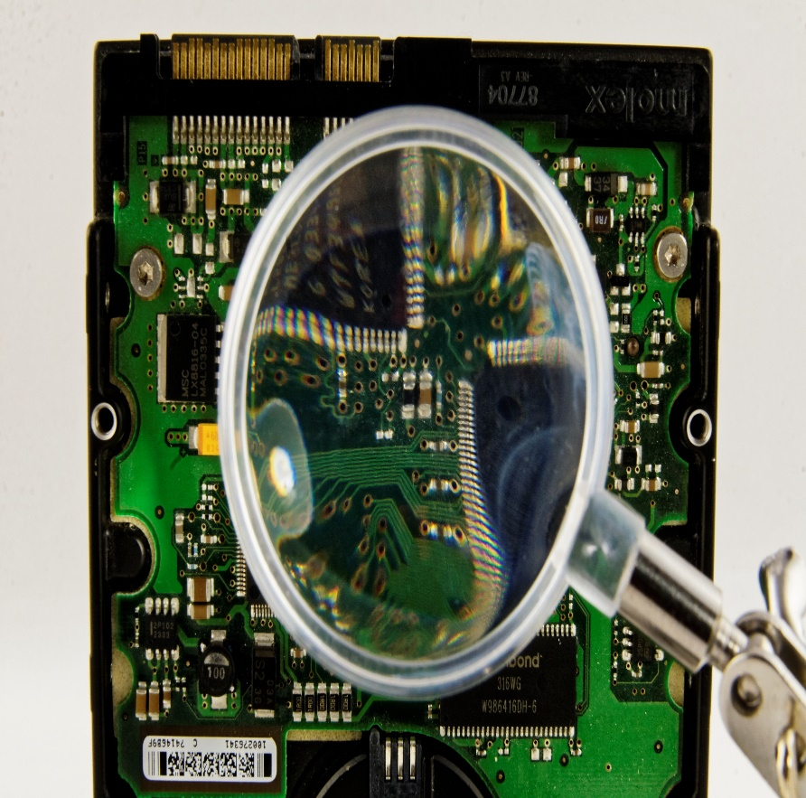
ROPA and AI
Aid transparency by keeping detailed records of processes, procedures and data used for AI applications
Highlight high risk areas which require further impact assessments and, potentially, mitigation strategies and changes to the product
Lomas & Almeida 2021

Slide 36
Part 3 – Activity and Readings
Using the provided ICO Records of Processing Template, create records for an AI/ML driven process within your organization.
Read through the ICO guidelines on Records of Processing Activities and the ICO and The Alan Turing Institute's guidance on explainable AI, particularly task 2 of part 2, for further support in this activity.
Lomas & Almeida 2021

Slide 37
Part 4 Impact Assessments
Notes:
Part 1: Legislation and Regulatory Contexts
Part 2: Intellectual Property Rights
Part 3: Personal Data Concepts: the GDPR and AI
Part 4: GDPR in practice: RoPA
Part 5: GDPR in practice: Impact Assessments
Part 6 Case-Study: AI-driven Recruitment
Part 7: Future gazing: ePrivacy and AI regulation
Activities and Readings

Slide 38

Impact Assessments
Impact assessment (IA) is a structured a process for considering the implications, for people and their environment, of proposed actions while there is still an opportunity to modify (or even, if appropriate, abandon) the proposals. It is applied at all levels of decision-making, from policies to specific projects.
Data Protection Impact Assessments (DPIA) are a legal requirement of the GDPR for all potentially high-risk activities, including “new technologies” and “innovative processes”
AI would fall under both requirements –
a DPIA is encouraged for all AI projects which involve personal data
This Photo by Unknown Author is licensed under CC BY-NC
Lomas & Almeida 2021

Slide 39
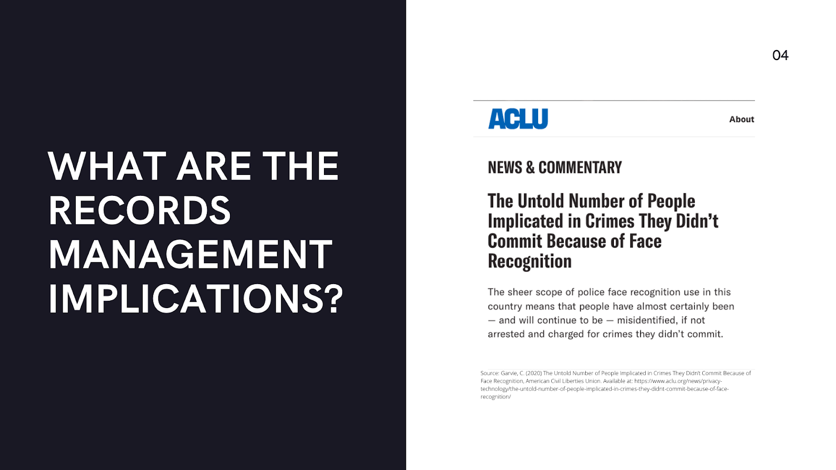
Records Management Implications
Issues of inaccuracy, particularly exacerbated when the data relates to people belonging to minority groups (see Fairness and AI module);
Lack of accountability and explainability: records not kept or accessible following a match, giving no recourse to individuals;
Keeping track of lawful basis of processing;
For archives management, specifically, the use of algorithms for the appraisal of archives also needs to be addressed from an ethical standpoint, as human biases can be built into the algorithms in question.
Lomas & Almeida 2021

Slide 40
Part 4 - Readings
On issues of global governance:
Digital Platforms Require a Global Governance Framework (2019) Centre for International Governance Innovation. Available at: https://www.cigionline.org/articles/digital-platforms-require-global-governance-framework
On impact assessments as a framework for auditing:
Kazim, E., Denny, D. M. T. and Koshiyama, A. (2021) ‘AI auditing and impact assessment: according to the UK information commissioner’s office’, AI and Ethics. doi: 10.1007/s43681-021-00039-2.
Lomas & Almeida 2021

Slide 41
Part 5 Case-Study: AI-driven Recruitment
Notes:
Part 5: GDPR in practice: Impact Assessments
Part 6 Case-Study: AI-driven Recruitment
Part 7: Future gazing: ePrivacy and AI regulation
Activities and Readings

Slide 42
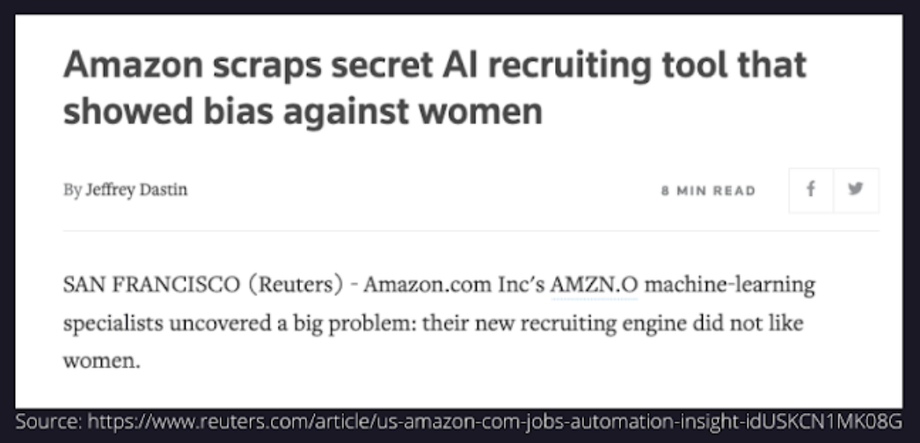
Recruitment
What went wrong?
Special category data collected without enough consideration or legal basis for processing;
No privacy assessment conducted to consider the privacy implications of the use of the algorithm;
No considerations for algorithmic bias and bias associated with the input data.
Lomas & Almeida 2021

Slide 43
Part 5 - Readings
Reuters article on the Amazon AI recruitment tool: https://www.reuters.com/article/us-amazon-com-jobs-automation-insight-idUSKCN1MK08G
On job seekers attitudes towards AI driven recruitment: Friedrich-Alexander-University, Schöller Endowed Chair for Information Systems, Erlangen-Nuremberg, Germany, Ochmann, J. and Laumer, S. (2020) ‘AI Recruitment: Explaining job seekers’ acceptance of automation in human resource management’, in heine, M., Poustcchi, K., and Krasnova, H., WI2020 Zentrale Tracks. GITO Verlag, pp. 1633–1648. doi: 10.30844/wi_2020_q1-ochmann.
Lomas & Almeida 2021

Slide 44
Part 6 Future gazing: ePrivacy and AI regulation
Notes:
Part 5: GDPR in practice: Impact Assessments
Part 6 Case-Study: AI-driven Recruitment
Part 7: Future gazing: ePrivacy and AI regulation
Activities and Readings

Slide 45
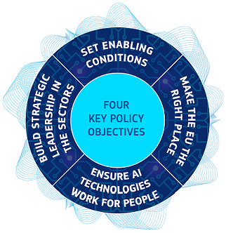
Incoming regulations
The EU regulatory proposal aims to provide AI developers, deployers and users with clear requirements and obligations regarding specific uses of AI.
The EU's strategy on AI is focused on 3 goals:
place Europe ahead of technological developments and encourage the uptake of AI by the public and private sectors
prepare for socio-economic changes brought about by AI
ensure an appropriate ethical and legal framework
The long-awaited ePrivacy regulation should also provide a​ helpful regulatory context to enforce on online privacy issues associated with AI, such as real-time bidding.

Slide 46

A new legislative paradigm?
Responsibilities?
1. How have you controlled the development, testing, rollout and then implementation in context of AI systems ensuring the management and challenge of bias?
2. What specific consents, notices and checks and balances are in place for fairness and transparency for these purposes?
3. On what basis have the data banks been built and used in relation to which purposes?
4. What specific consents, notices and checks and balances are in place for fairness and transparency for data bank accrual and use and what should not be allowable in terms of data scraping etc?
Lomas & Almeida 2021
This Photo by Unknown Author is licensed under CC BY-SA-NC

Slide 47

A new legislative paradigm?
5. What are the limitations of AI performance capabilities for different purposes taking into consideration the design context?
6. What accountability is in place for different use?
8. How can this accountability be explicitly exercised, explained and audited for a range of stakeholder needs?
9. How are complaint and challenge processes enabled and afforded to all?
10. Can counter-AI initiatives be conducted to challenge and test law enforcement and audit systems?
Lomas & Almeida 2021
This Photo by Unknown Author is licensed under CC BY-NC-ND

Slide 48

Thank you!

Slide 49
Part 6 - Readings
European Union's Coordinated Plan on Artificial Intelligence 2021 (https://digital-strategy.ec.europa.eu/en/policies/plan-ai) alongside point 1 (Explanatory Context) of the proposed Artificial Intelligence Act: https://eur-lex.europa.eu/legal-content/EN/TXT/?qid=1623335154975&uri=CELEX%3A52021PC0206
EU proposal for an ePrivacy Regulation: https://digital-strategy.ec.europa.eu/en/policies/eprivacy-regulation
Veale, M. and Borgesius, F.Z., 2021. Adtech and Real-Time Bidding under European Data Protection Law. Available at: https://osf.io/preprints/socarxiv/wg8fq/
Lomas & Almeida 2021

Slide 50
All Activities and Readings with additional readings and links
Notes:
Part 5: GDPR in practice: Impact Assessments
Part 6 Case-Study: AI-driven Recruitment
Part 7: Future gazing: ePrivacy and AI regulation
Activities and Readings

Slide 51
Readings and Activities Overview
Readings and activities have been provided for the respective parts of each learning unit.
These readings should form the point of departure for further reading.
Lomas & Almeida 2021

Slide 52
Part 1-Activity: Mapping out the legislative and regulatory landscape
To map out the legislative context either for your organization or an organization you are familiar with. Consider:
What is the broad legislative context?
Who are the regulators?
How/where/why might AI be developed/deployed?
Who are the stakeholders?
What could be the benefits of AI in this context?
What responsibilities exist?
What might be the risks taking into account any issues around potential harm or damage or rights infringements?
Lomas & Almeida 2021

Slide 53
Part 1 - Readings
Read Chapter 3 on ‘Who bears responsibility for the threats, risks, harms and wrongs posed by advanced digital technologies?’, in Yeung, K. ed. (2019) Responsibility and AI: a study of the implications of advanced digital technologies (including AI systems) for the concept of responsibility within a human rights framework. Strasbourg: Council of Europe. Available at: https://rm.coe.int/responsability-and-ai-en/168097d9c5 (Accessed 1 July 2021)
Lomas & Almeida 2021

Slide 54
Part 2 – Readings
Read the ICO’s 2020 discussions on addressing risks of bias and discrimination in AI design which are at https://ico.org.uk/for-organisations/guide-to-data-protection/key-data-protection-themes/guidance-on-ai-and-data-protection/what-do-we-need-to-do-to-ensure-lawfulness-fairness-and-transparency-in-ai-systems/#howshouldweaddress . These sections are within its Guidance on Data Protection and AI. The full publication is available at: https://ico.org.uk/for-organisations/guide-to-data-protection/key-data-protection-themes/guidance-on-ai-and-data-protection/ (Accessed 1 July 2021). Whilst this is a guide from the UK's Information Commissioner, it provides considerations of how to build an AI framework which is compatible with data protection legislation and as a whole will provide you with many critical points for developing and deploying an AI system.
Lomas & Almeida 2021

Slide 55
Part 2 – Activities
In addition, building on your Part 1 mapping of the regulatory and legislative landscape, you may wish to look at one of the following links, considering global differences and synergies in data protection law. The DLA Piper link provides an easy tool for comparisons.
Data Protection and Privacy Legislation Worldwide
https://unctad.org/page/data-protection-and-privacy-legislation-worldwide
DLA Piper’s Data Protection Laws of the World
https://www.dlapiperdataprotection.com/
EU GDPR Law Comparison
https://www.activemind.legal/law/
Lomas & Almeida 2021

Slide 56
Part 3 – Activity and Readings
Using the provided ICO Records of Processing Template, create records for an AI/ML driven process within your organization.
Read through the ICO guidelines on Records of Processing Activities and the ICO and The Alan Turing Institute's guidance on explainable AI, particularly task 2 of part 2, for further support in this activity.
Lomas & Almeida 2021

Slide 57
Part 4 - Readings
On issues of global governance:
Digital Platforms Require a Global Governance Framework (2019) Centre for International Governance Innovation. Available at: https://www.cigionline.org/articles/digital-platforms-require-global-governance-framework
On impact assessments as a framework for auditing:
Kazim, E., Denny, D. M. T. and Koshiyama, A. (2021) ‘AI auditing and impact assessment: according to the UK information commissioner’s office’, AI and Ethics. doi: 10.1007/s43681-021-00039-2.
Lomas & Almeida 2021

Slide 58
Part 5 - Readings
Reuters article on the Amazon AI recruitment tool: https://www.reuters.com/article/us-amazon-com-jobs-automation-insight-idUSKCN1MK08G
On job seekers attitudes towards AI driven recruitment: Friedrich-Alexander-University, Schöller Endowed Chair for Information Systems, Erlangen-Nuremberg, Germany, Ochmann, J. and Laumer, S. (2020) ‘AI Recruitment: Explaining job seekers’ acceptance of automation in human resource management’, in heine, M., Poustcchi, K., and Krasnova, H., WI2020 Zentrale Tracks. GITO Verlag, pp. 1633–1648. doi: 10.30844/wi_2020_q1-ochmann.
Lomas & Almeida 2021

Slide 59
Part 6 - Readings
European Union's Coordinated Plan on Artificial Intelligence 2021 (https://digital-strategy.ec.europa.eu/en/policies/plan-ai) alongside point 1 (Explanatory Context) of the proposed Artificial Intelligence Act: https://eur-lex.europa.eu/legal-content/EN/TXT/?qid=1623335154975&uri=CELEX%3A52021PC0206
EU proposal for an ePrivacy Regulation: https://digital-strategy.ec.europa.eu/en/policies/eprivacy-regulation
Veale, M. and Borgesius, F.Z., 2021. Adtech and Real-Time Bidding under European Data Protection Law. Available at: https://osf.io/preprints/socarxiv/wg8fq/
Lomas & Almeida 2021

Slide 60
A Few Further Readings and Links
European Data Protection Board Guidance https://edpb.europa.eu/our-work-tools/general-guidance/guidelines-recommendations-best-practices_en
General Data Protection Regulation https://gdpr-info.eu/
Human Rights Watch – Privacy News, e.g. https://www.hrw.org/news/2018/04/19/data-privacy-human-right and https://www.hrw.org/report/2021/06/16/my-life-not-your-porn/digital-sex-crimes-south-korea
UNESCO https://en.unesco.org/artificial-intelligence
United Nations – AI News, e.g. https://www.un.org/en/chronicle/article/towards-ethics-artificial-intelligence
Lomas & Almeida 2021

Slide 61
A Few Further Readings and Links
Almeida, D., Shmarko, K. and Lomas, E. (2021) ‘The ethics of facial recognition technologies, surveillance and accountability in an age of Artificial Intelligence: a comparative analysis of USA, EU and UK regulatory frameworks. Forthcoming, AI Auditing, Assurance, and Certification. AI and Ethics. Springer. ISSN: 2730-5961, Available at SSRN: https://ssrn.com/abstract=3878867 or http://dx.doi.org/10.2139/ssrn.3878867
Kaminski, M., and Malgieri, G. (2020) ‘Algorithmic impact assessments under the GDPR: producing multi-layered explanations’, International Data Privacy Law, 2020;, ipaa020, https://doi.org/10.1093/idpl/ipaa020.
Koshiyama, A. et al. (2021) ‘Towards algorithm auditing: a survey on managing legal, ethical and technological risks of AI, ML and associated algorithms’. Available at SSRN: https://ssrn.com/abstract=3778998 or http://dx.doi.org/10.2139/ssrn.3778998
Lomas & Almeida 2021

